Slide 1
Modius OpenData
Solutions for Infrastructure Management
Craig Compiano, President
Mark Carberry, Vice President of Sales
November 13, 2020

Slide 2
Introductions

Slide 3
Your Needs Might Include
The Modius Solution
Consolidated platform for monitoring
Connectivity for real-time data collection
Analytics including computing key performance metrics
Accurate data for reports and BI
A turnkey solution
A flexible partner who can get started quickly
A solution that’s scalable
A solution that’s easy to administer
Provides single view for all equipment and locations
Uses industry standard protocols and security
Utilizes distributed edge computers for analytics
Stores real-time data in SQL database you own
Provides a “one-stop-shop” by bringing together software, field services, and manufacturing partners
Can start quickly by leveraging software specifically developed for distributed infrastructure
Works just as well for 1 location as it does for many
Includes UI for configuration, not programming

Slide 4

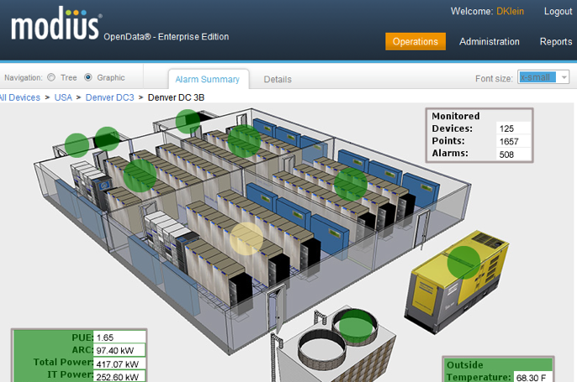
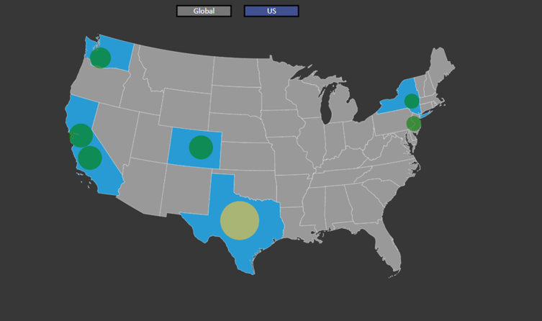
Who is Modius?
Who is Modius?
  Modius provides the solutions for managing the availability, capacity and efficiency of critical facilities
  Based in San Francisco, CA
  Deployed in production environments since 2007
  Veteran owned small business (VOSB)
  Product: OpenData®
Notes:
Consider replacing Modius providers solutions for Infrastructure Management with
“ Modius provides the solutions for managing the availability, capacity and efficiency of critical facilities.”

Slide 5



What is OpenData?
OpenData provides all the tools you need to manage the performance of mission critical infrastructure including data centers, smart buildings, telecommunication sites, production facilities, and more
Notes:
Is this the right place for: OpenData provides all the tools you need to manage the performance of your mission critical infrastructure, from integration of disparate devices, to analytics, to integrated dashboards, i.e. all in a “single pane of glass”
It is so long, you may just wish to use: OpenData provides all the tools you need to manage the performance of your mission critical infrastructure

Slide 6

Typical Projects Have…
  Highly disparate physical infrastructure
  Multiple systems for monitoring
  Geographically distributed locations
  Locations which are differentiated in size & maturity
  Existing monitoring deemed inadequate or inefficient to use
  Uncertain use-cases complicating project definition & pricing
End Goal
  Provide flexible aggregation of all critical infrastructure with easy data access

Slide 7








Summary of OpenData Key Features
  Ready to deploy
  End-to-End solution
  Accurate & structured IoT data
  Highly scalable & secure
  Commodity hardware (lower cost)
  Cloud or On-Prem
  Easy-to-deploy (lower cost)
  Expandable to many use cases

Slide 8

Ready to Deploy
Ready to deploy – a key value prop
Modius might have 95% of what you want today…
…without the cost,
risk, and delay of doing-it-yourself!
Benefit
Eliminates the cost, risk and delay of doing it yourself!

Slide 9

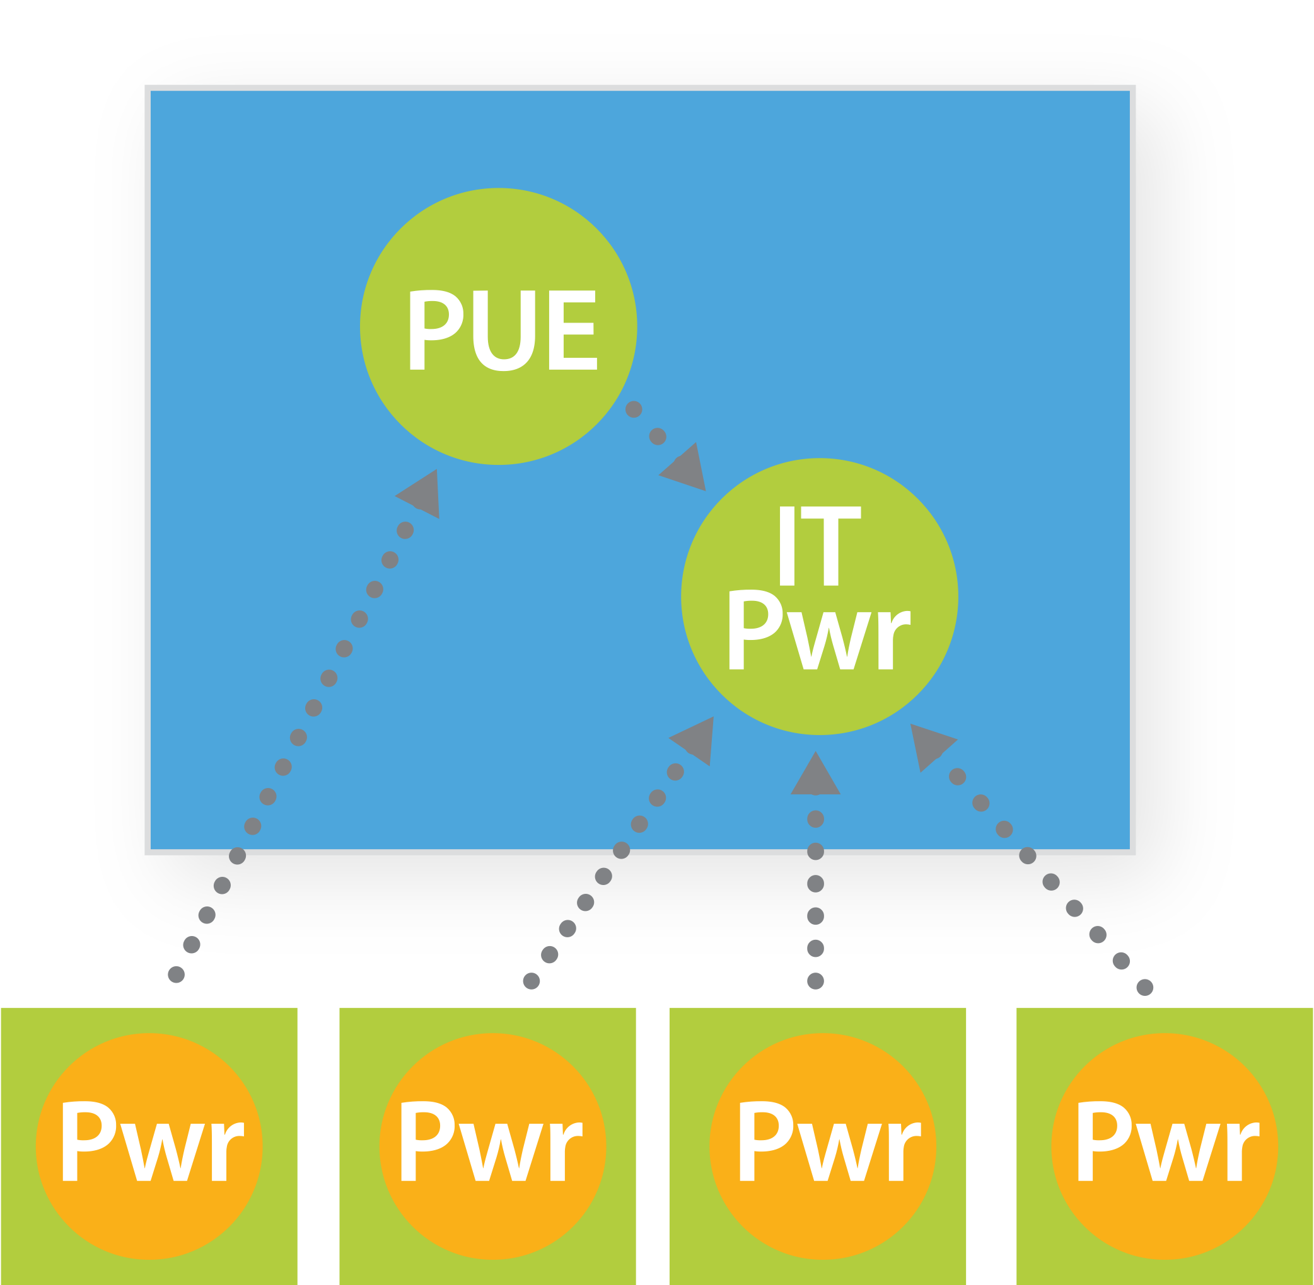
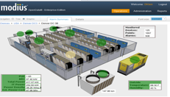


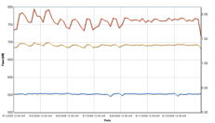


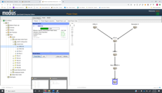


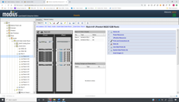
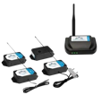
End to End Solution to Collect > Analyze > Act
How OpenData works: Collect Act
Monitored Equipment
OpenData Collector
OpenData Application
OpenData Visualization
CRACs & AHUs
Remote Monitoring
Chillers, HVACS, Generators
Physical Server or VM
Intelligent Power Strips
LAN/WAN
Analytics Management
UPS’s, Power Distribution Units
Selected IT Gear
or IoT
Gateway
Event and Performance Data
Power Chain Management
Poll Devices = 4x Min
All communication protocols (Modbus/BACnet/SNMP, etc.)
All equipment types
(both networked + serial)
All vendors, makes & models
Record Data = 1x Min
Normalized data
Time synchronized
Computed metrics
Serial Gateways
Asset Management
Sensor Arrays
Benefit
Pinpoint exactly where problems occur when they occur

Slide 10
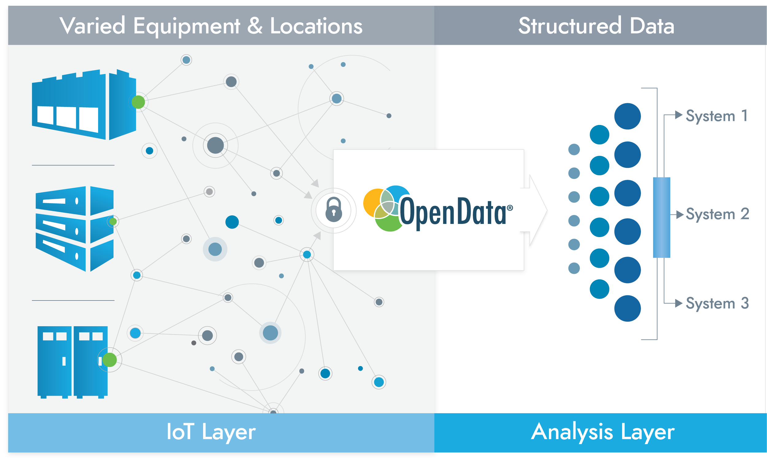
Accurate and Structured for Edge Computing
Benefit
Hard-to-get data becomes usable data

Slide 11
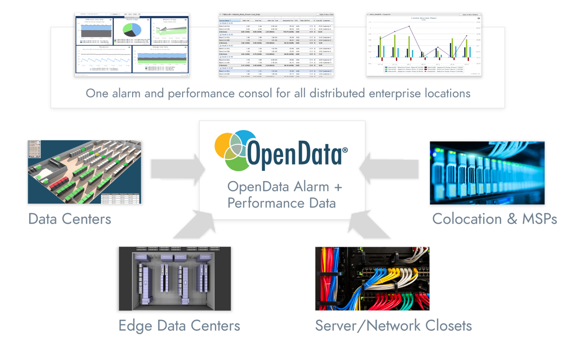
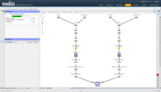
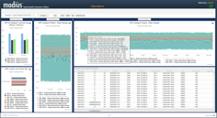

Highly Scalable and Secure
OpenData – Enterprise Edition
Secure TCP “push”
Benefit
Deploy at 1, 10 or 10,000 locations with equivalent performance

Slide 12
Cloud or On-Premise
OpenData EE is typically deployed centrally in the cloud for subscription users, or on-premises for end users
or
Cloud
Host it yourself
Benefit
Deploy OpenData however you need it

Slide 13
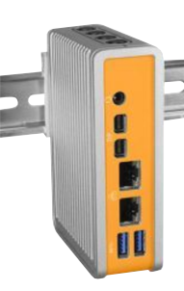
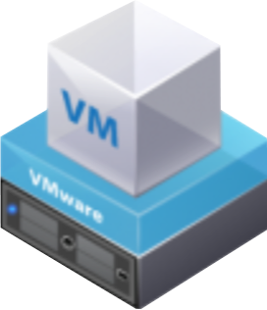
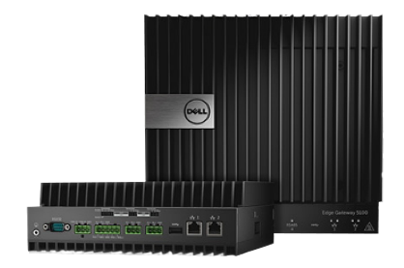
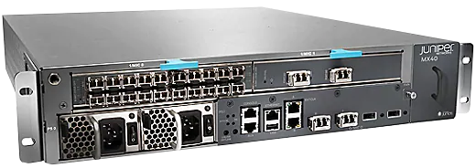
Commodity Hardware for Gateways
Commodity hardware for gateways
Each location has edge-oriented server called a gateway.
OpenData is compatible with VM or many gateway makes & models.
Benefit
Gateway distributes compute power to enable you to scale gracefully

Slide 14
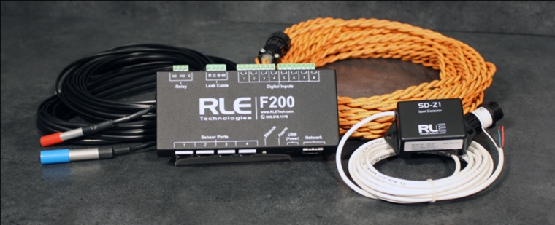




Commodity Hardware for Physical I/O
Commodity hardware for physical I/O
A gateway can be paired with environmental monitoring appliances
Temperature
Humidity
Door Open / Intrusion
Water
Smoke/Fire
Battery health
Energy measurements
Dry-contact alarms
RTU
water
Remote Telemetry Units (RTUs) can be purchased with or without sensors
Benefit
Provides interface to physical contacts and sensors

Slide 15

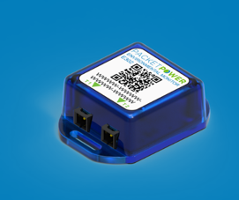

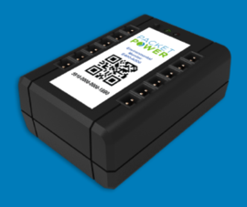
Commodity Hardware for Wireless Sensors
Wireless sensors for power, temperature, and more…
E300
E302
E306
E312
1 temperature point
No external probe ports
Dew point and relative humidity included
Battery powered
(4+ year life)
Up to 3 temperature points
Two external probe ports
Dew point and relative humidity included
Battery powered
(4+ year life)
Up to 6 temperature points
Six external probe ports
Dew point and relative humidity optional
Differential pressure optional
Local display
Battery powered (for PoE splitter)
Up to 12 temperature points
Twelve external probe ports
Dew point and relative humidity optional
Battery powered
(15+ year life) or AC powered
Benefit
Easier to install and can support multiple measurements per node

Slide 16
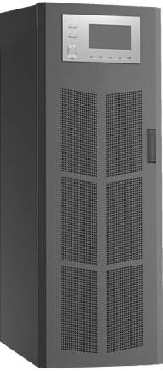
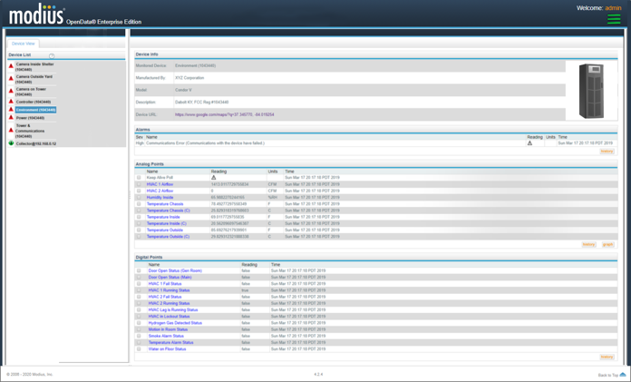
Easy to Deploy Approach
Commodity hardware for wireless sensors
Template configuration defines how devices are represented in software (i.e. digital twin)
All Device Values Mapped
Template Configuration Supported
Modbus BACnet,
and SNMP and other OT protocols
Benefit
Lower cost

Slide 17
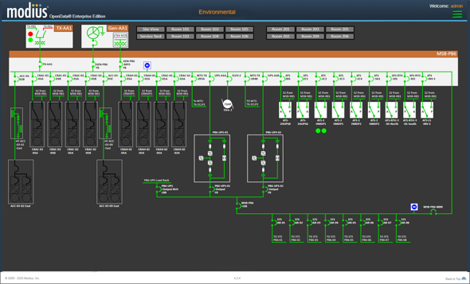
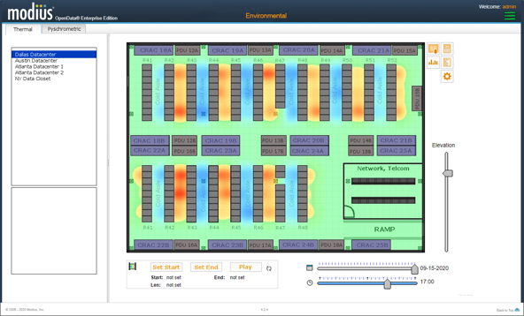
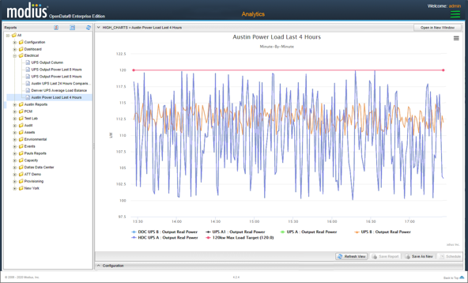
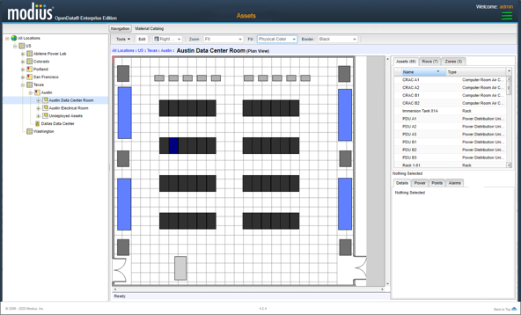
Expandable to Many Use Cases
  Power Management
  Environmental Management
  Predictive
  Analytics
  Asset Management

Slide 18
5 Modules

Slide 19
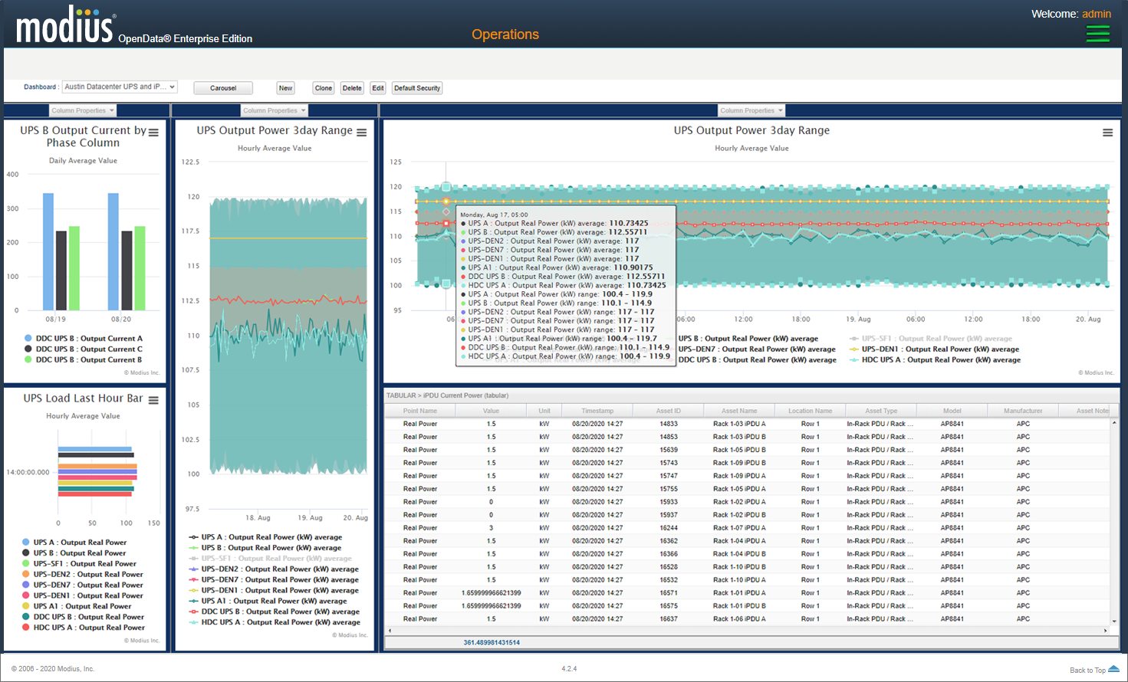

Module 1: Power Capacity Management
Monitor where power enters building all the way through various distribution points.
Provides precise visibility of power flow to expose problems and opportunities to improve over and under allocation.

Slide 20
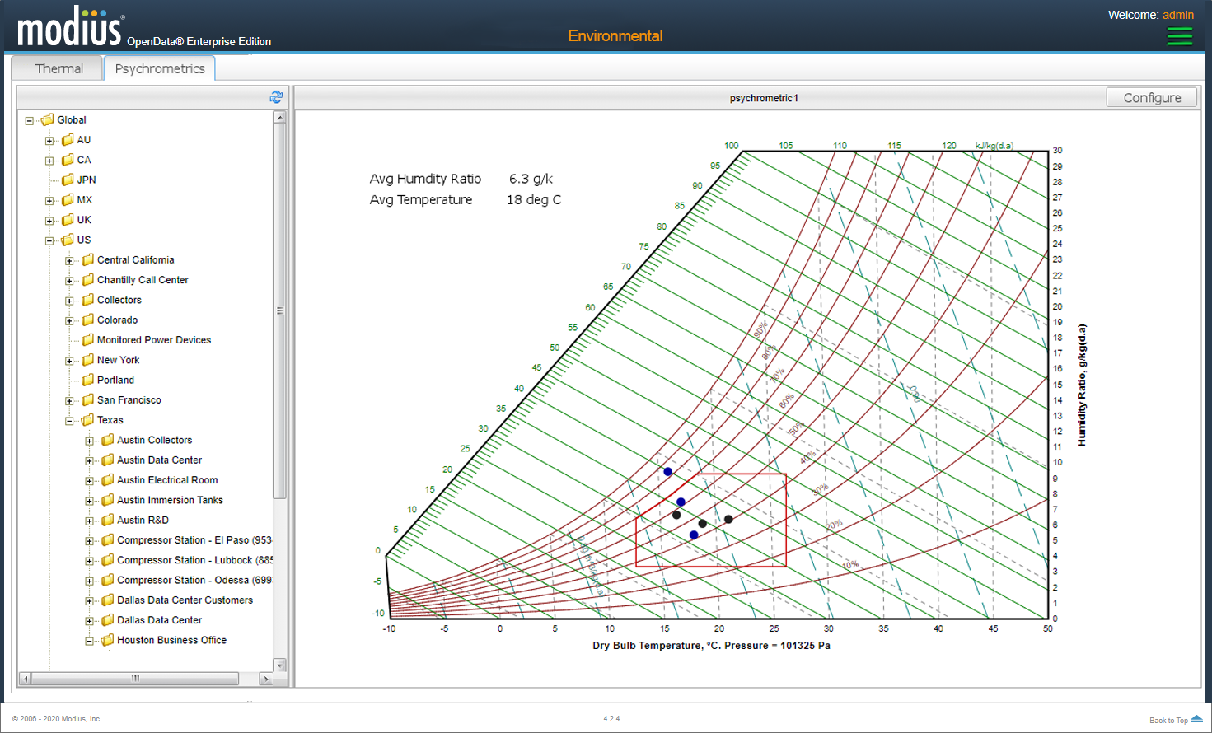
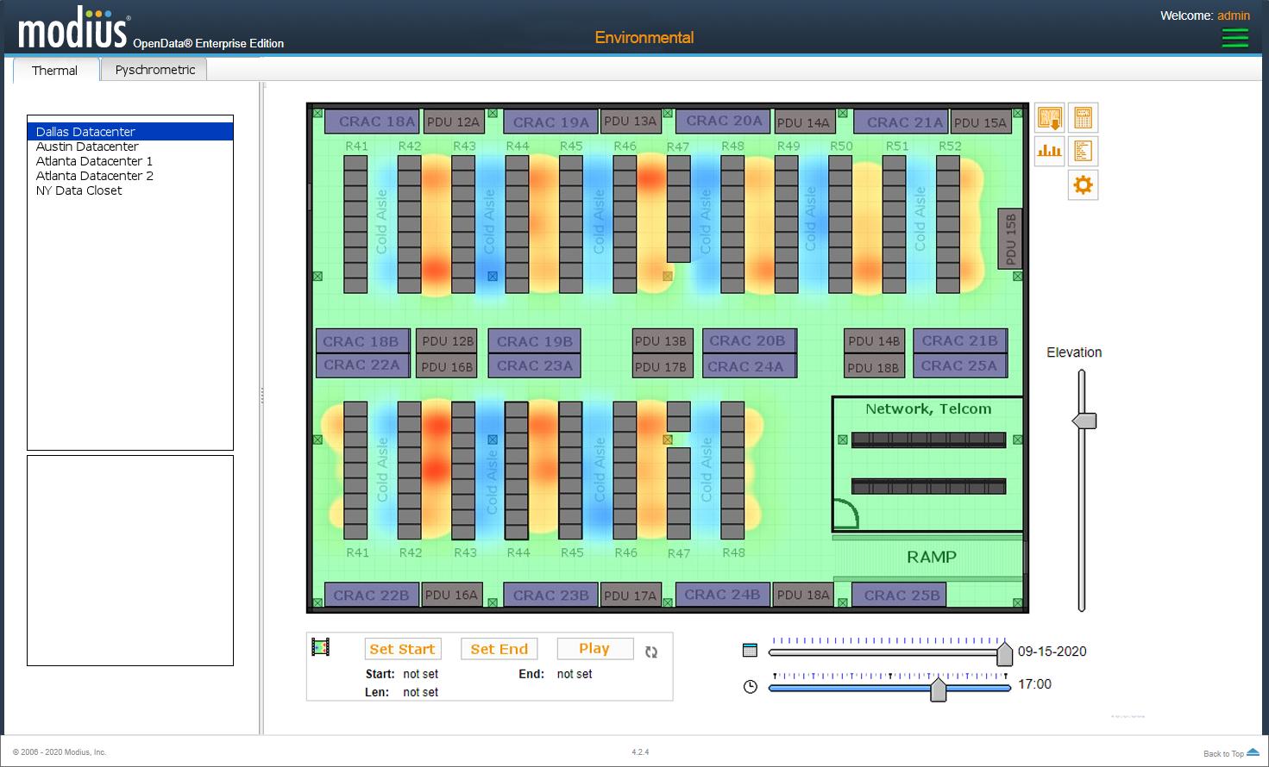
Module 2: Environmental Management
For more zone-level capacity analysis and monitoring of thermal gradients within the data center for better identification of hot/cold spots and cooling capacity. Support for psychometric charts.

Slide 21
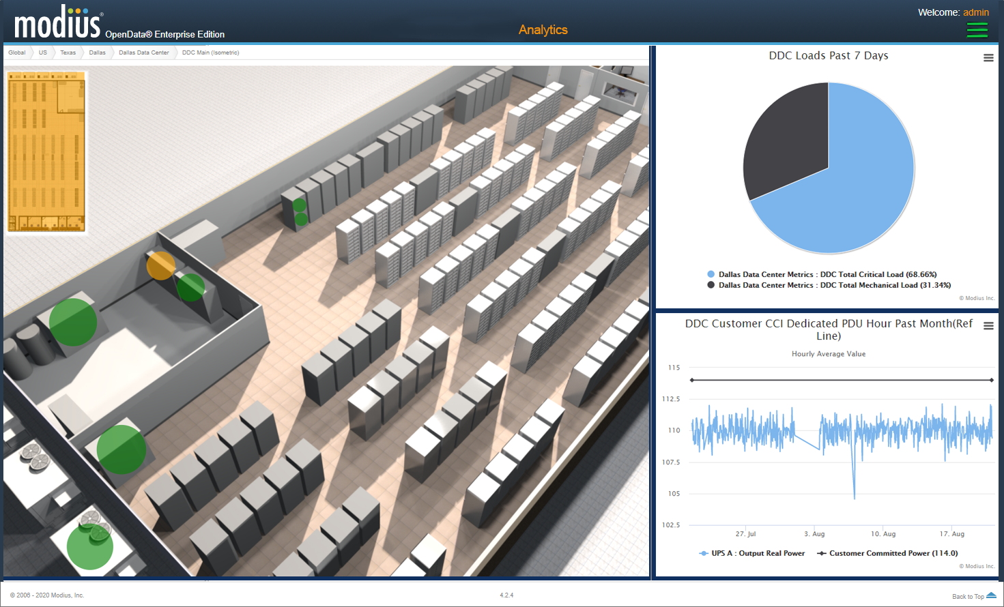

Module 3: Analytics Management
Analytic screens for reporting, charting, and dashboards, all utilizing and standard analytics engine. Uplifts to the Analytics Management module are available.

Slide 22

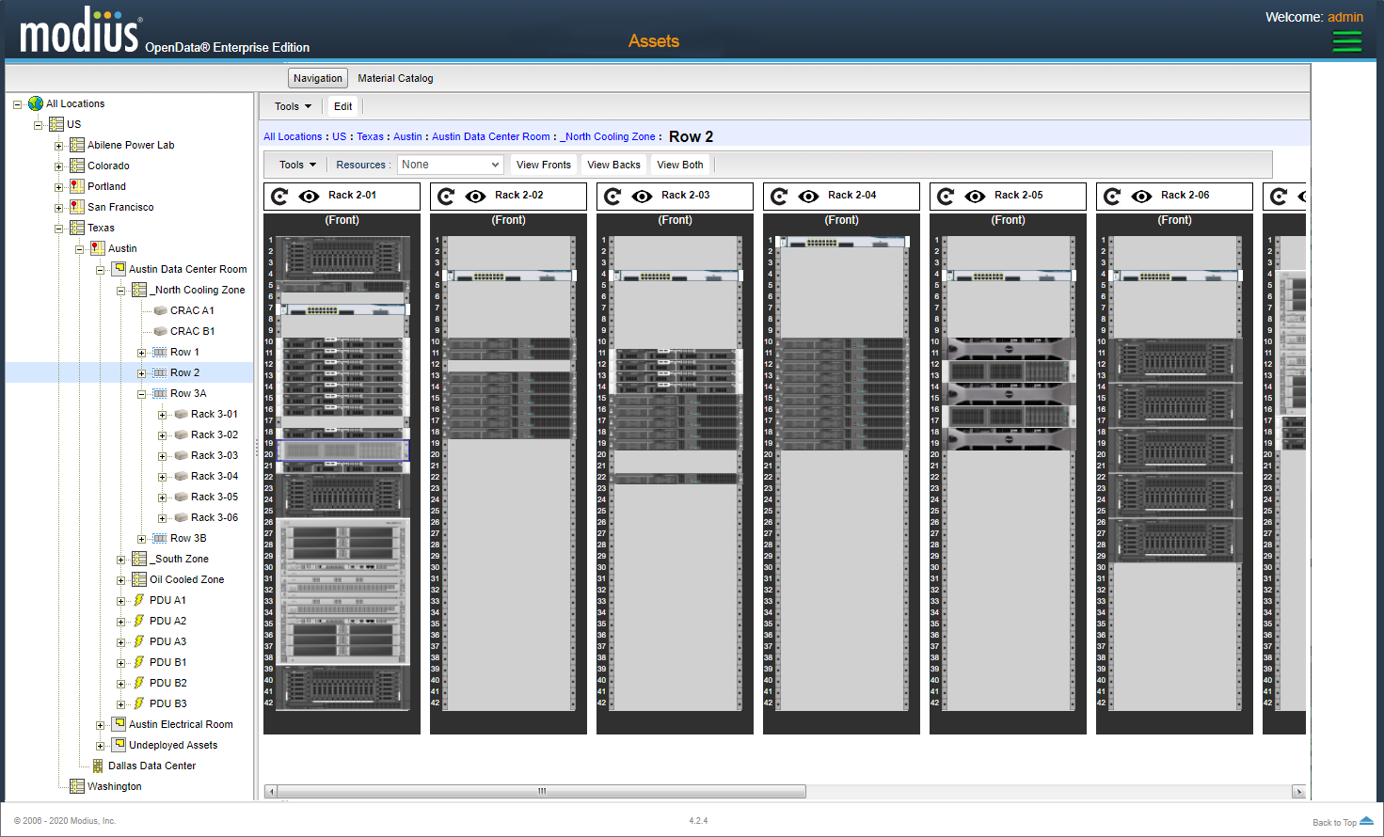
Module 4: Asset Management
Virtualize individual assets to manage closely location, space capacities, changeouts, and more.

Slide 23
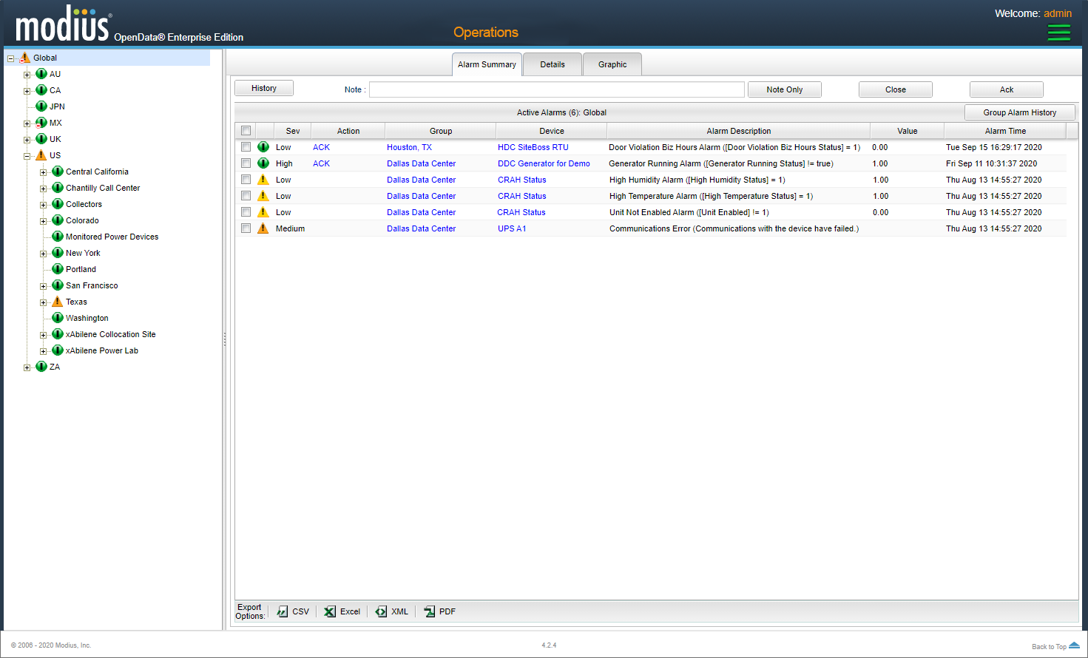
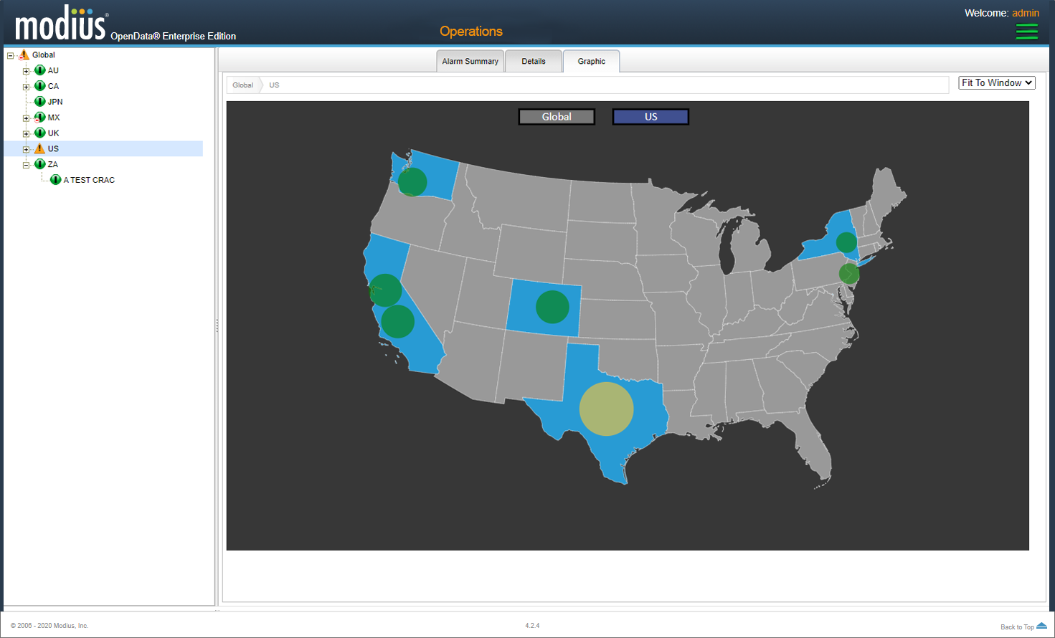
Module 5: Remote Monitoring
Tree Style Navigation
Graphical Navigation
Operations screens for alarm management, notification, and graphics. Uplifts to the Remote Monitoring module are available to further enhance capabilities.

Slide 24
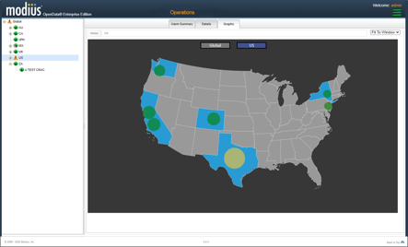
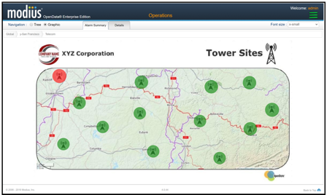
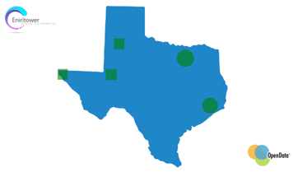
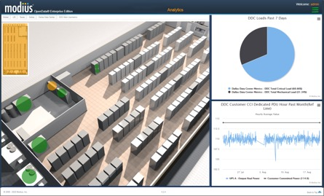
Multi-Layer Graphics
Summary View
Regional View(s)
Location Summary View

Slide 25
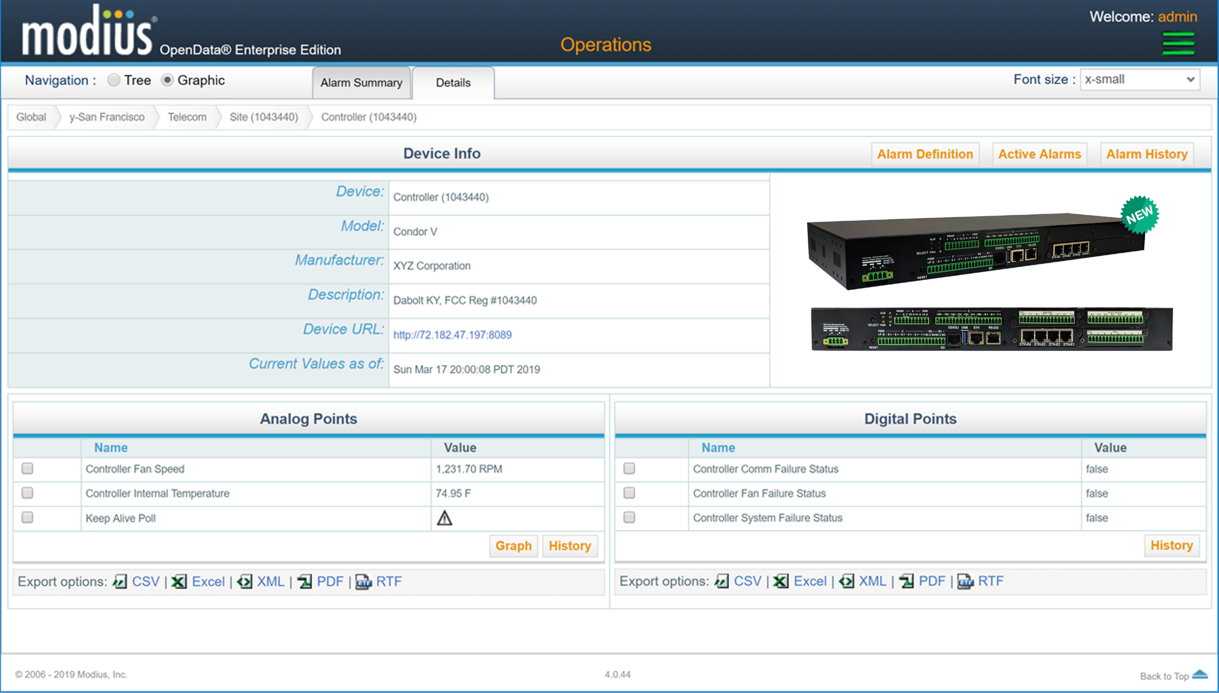



Device Level Information

Slide 26
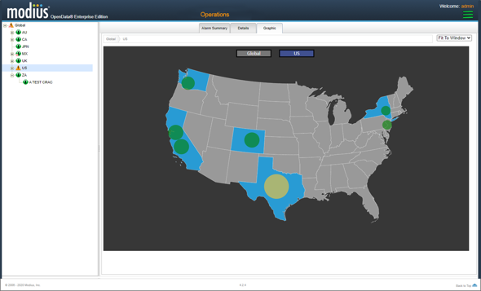

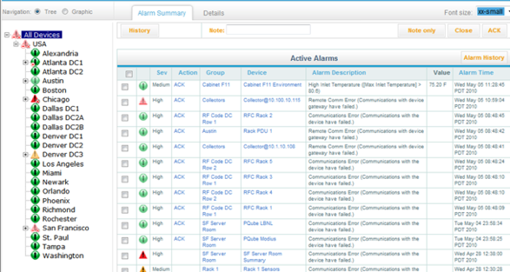
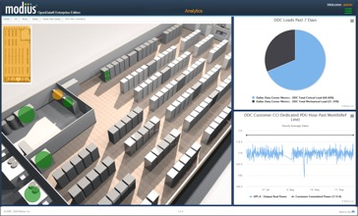


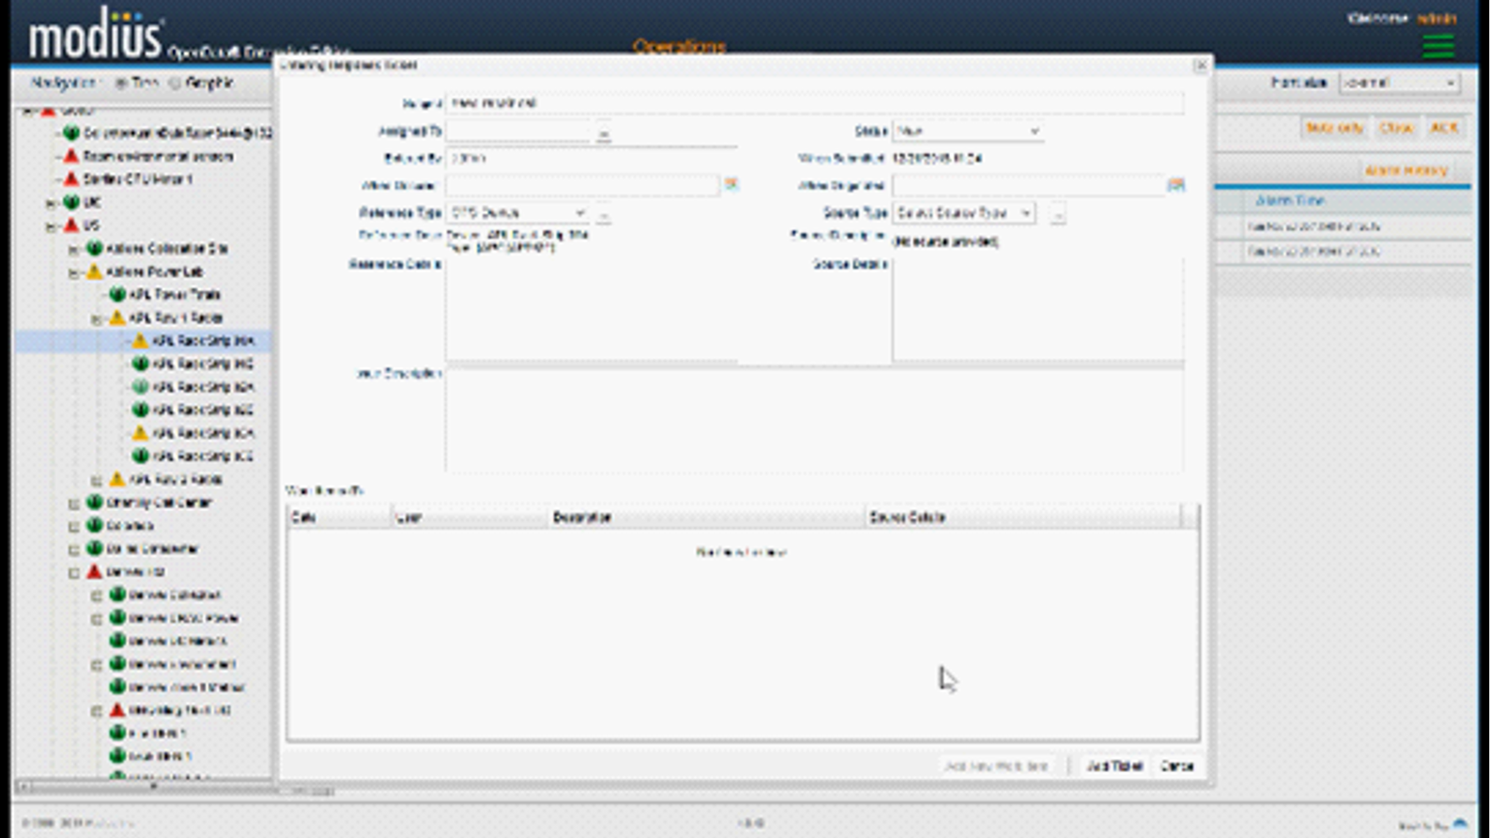


Alarm Management
Summary View
Specific
View
  Notification & Escalation
  Service Tickets

Slide 27
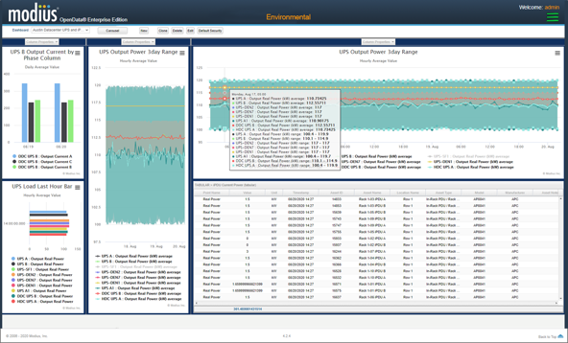
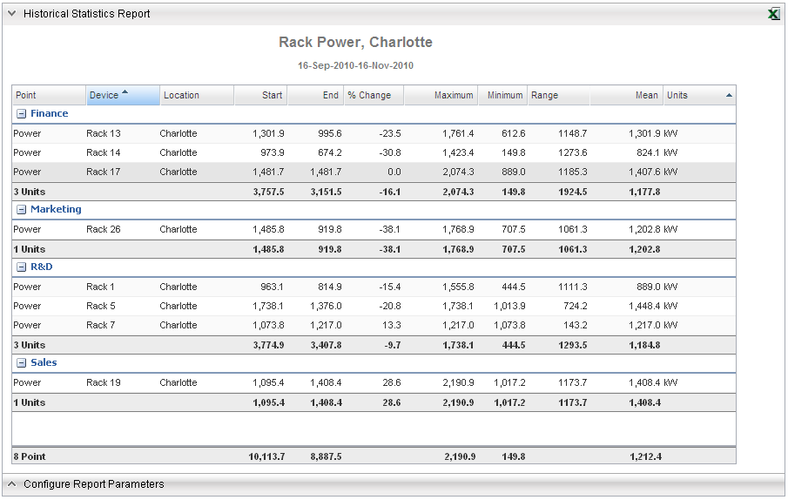
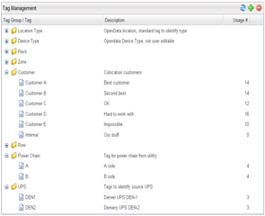
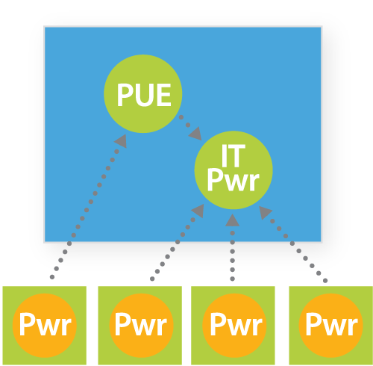
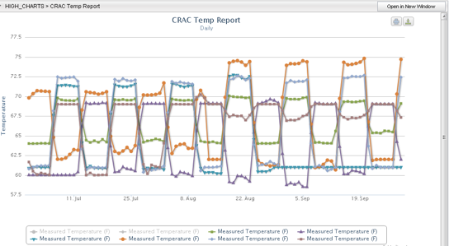
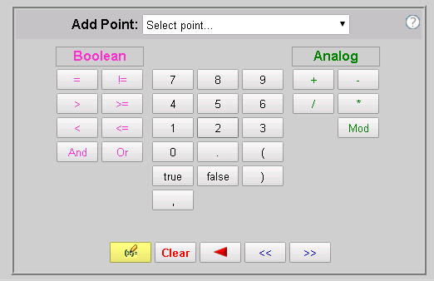
Performance Management
  Analytic Reports
  Analytic Dashboards
  Time-series Charts
  Computed Metrics
Transfer Switch
PDU 1
PDU 2
PDU 3
= Native point
= Computed point

Slide 28

Case Study

Slide 29

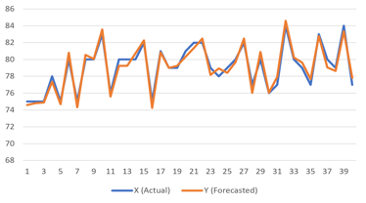
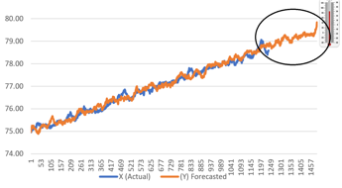
Forecasting Using Predictive Analytics
Case Study
High Temperature Alarms
can be avoided. Extreme temperatures and lack of quick remote resources can lead to costly maintenance calls, downtime, and server replacement.
OpenData is always analyzing data for early warning. A measurement as simple as temperature can be used to detect airflow issues and forecasted to detect high temperature before alarm even occurs.
Outcome
Enables you to be proactive rather than reactive to problems.
Cooling
Zones
Forecasted vs. Actual Temperature
Forecasted Problem

Slide 30










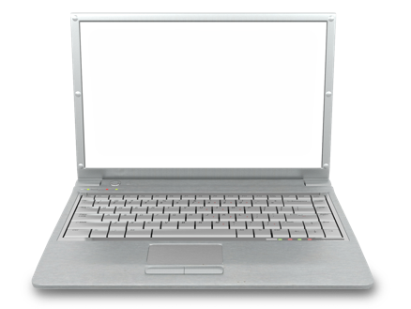

Anomaly Detection Using Predictive Analytics
Case Study
Real-Time Algorithm Fault Detection
Time Series
Historical logs helped OpenData determine abnormal behavior well before a failure occurred.
Vibration
Chiller is no longer able to cool effectively due to malfunctioning pump.
Outcome
OpenData predictive analytics was able to notify personnel of the impending failure so maintenance could be scheduled.

Slide 31

Ready to Deploy: Phased Deployment Strategy
  No-Risk POC
    Prepare device lists for joint integration efforts
    Construct and vet device templates
    OpenData trial system hosted by Modius in cloud
  Purchase
    Connect solution to your own OpenData instance
  Commissioning
    Final collaboration with integration & field teams
  Refine for expansion
    Implement support for desired customizations
    Federate IoT data for use by internal systems

Slide 32






Pricing for Enterprise Edition: Pay Only for What You Use
Unlimited
# of Users
…
User 1
User 2
User 3
OpenData Server-Side Application
Buy Server
Application
Only Once
  OpenData Alarm + Performance Data
Pay for
# of
Modules
Monitoring
Power Mgmt
Analytics
Asset Mgmt
Data Center 1
Data Center 2
Data Center 3
…
Unlimited # of Sites & Collectors
Pay for
# of
Devices
Unlimited # of Points
----
----
----
----
----
----
----
----
----
----
----
----
----
----
----
----
----
----
----
----
----
----
----
----
----
----
----
----
----
----
----
----
----

Slide 33
Open Data: Enterprise Platform with Application Modules
Web Portal
Application Integration
Dashboard, Reporting and Visualization
Condition
Monitoring
Power
Management
Environmental Management
Asset
Management
Analytics
and BI
Predictive Analytics
Dashboard, Reporting and Visualization
Identity and Access Management
Event Processing and Analytics
Device Integration & Sensor normalization
Aggregation, Message Broker, Enterprise Service Bus
Device/Sensor integration
& Data Normalization
Device/Sensor integration
& Data Normalization
Device/Sensor Integration
& Data Normalization

Slide 34


Open Data: Architecture Components
User Console
Integrated Charting and Reporting
Web Services
Dashboards
SQLdb
Computed Metrics
Event Manager
3rd Party Event Mgt
3rd Party Console
OpenData Message Bus
Network
OpenData Message Bus
Collector
Collector
Collector
Collector
BACnet
MODBUS
MODBUS
SNMP
Site 1
Site 2

Slide 35
Open Data: Internal Components
Protocol drivers not device drivers
XML Templates for Devices
Webforms to customize
Event Manager
Notifier
Alarm Manager
Subscriber
Encryption
Message
Broker
Persistence
Configurable Encryption
Client-initiated connection
Automatic data and configuration updates
Collector
Monitored Equipment
Publisher
Computed
Points and
Alarms
Protocol
Driver
Encryption
Monitored Equipment
Local Persistence

Slide 36
Network Bandwidth Requirements
Device to Collector
On average, 100 bytes per point per polling interval
Polling interval is configurable – varies by device
Power devices – typically every 10 seconds
Environmental sensors – typically every 60 seconds
SQLdb
OpenData Event Manager
Device
Collector
SQLdb
Collector to Event Manager
Approximately 100 bytes per point per reporting interval (default 1 minute)
Infrequently charging points are reported every 15 minutes
For a typical 42 circuit RPP (42 analog points, 84 alarm points)
4KB per reporting interval
12KB every 15 minutes

Slide 37
Summary of OpenData Key Features
  Ready to deploy
  End-to-End solution
  Accurate & structured IoT data
  Highly scalable & secure
  Commodity hardware (lower cost)
  Cloud or On-Prem
  Easy-to-deploy (lower cost)
  Expandable to many use cases

Slide 38

Thank You
Solutions for Data Center
Infrastructure Management
COLLECT | ANALYZE | ACT

Slide 39

Product UI Demonstration

Slide 40
Technology Customer Case Study
Case Study
Background
Software and Services company with over 4,000 employees in 60 countries
Data center N+1 cooling capacity was at risk based on the center’s rapid growth.
Management took action to optimize existing power and cooling resources and free up capacity to support more equipment in the existing space
Cap Costs
$710,000
Utility Incentive
$130,000
(18% of Capital Cost)
CapEx Cost Savings
$1.35M
OpEx Cost Savings
$262,000/Year
Energy Savings
2.3M kW/Year
Simple Payback
2.2 Years

